Slide 1


ITALIAN
CONSORTIUM
EU4EU Staff Mobility
Krakow, 07-08-09 June 2023

Slide 2
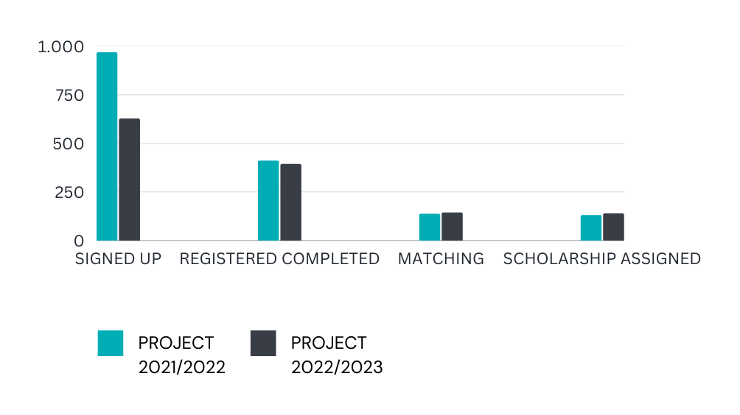
EU4EU ITALY

Slide 3
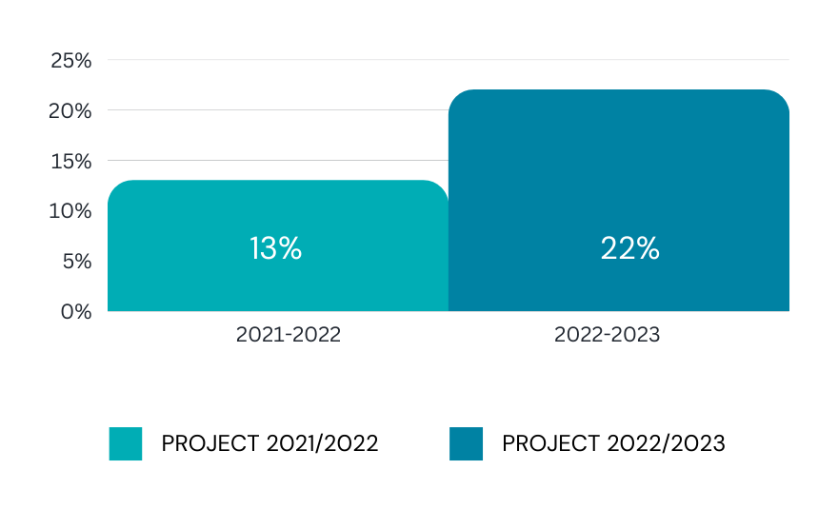
Signed up students who get the scholarship

Slide 4
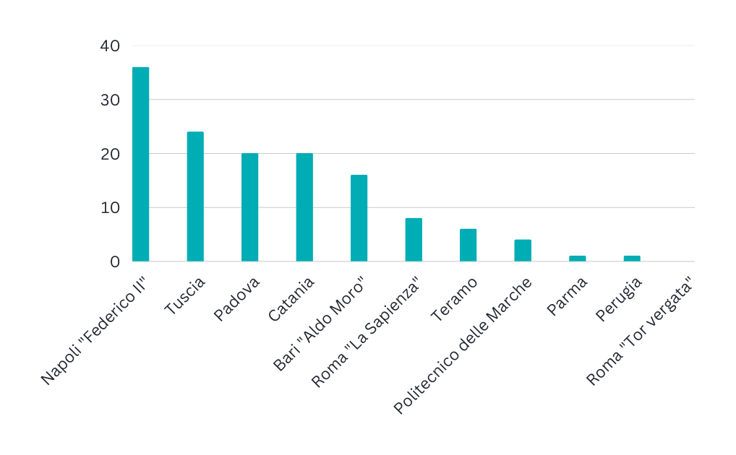
Matching per University 2021-2022
36
24
20
20
16
8
6
4
1
1
0

Slide 5
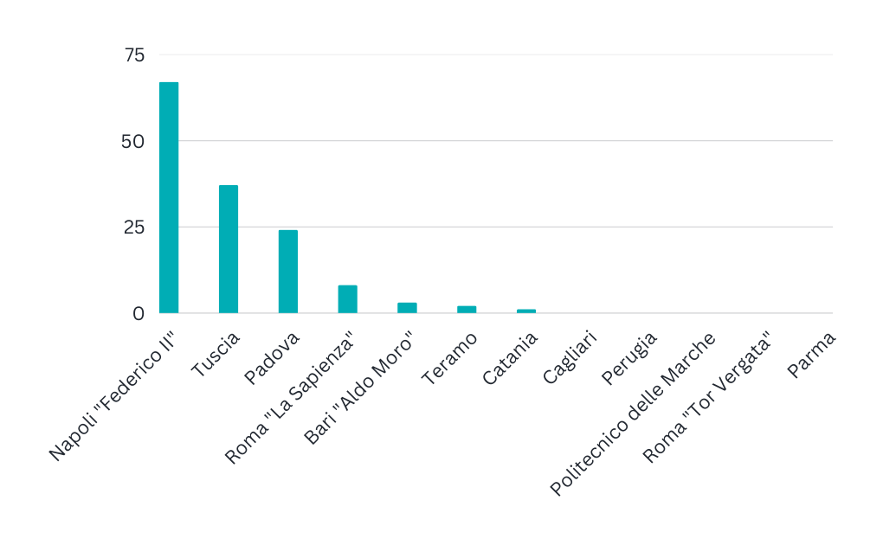
Matching per University 2022-2023
67
37
24
8
3
2
1
0
0
0
0
0

Slide 6
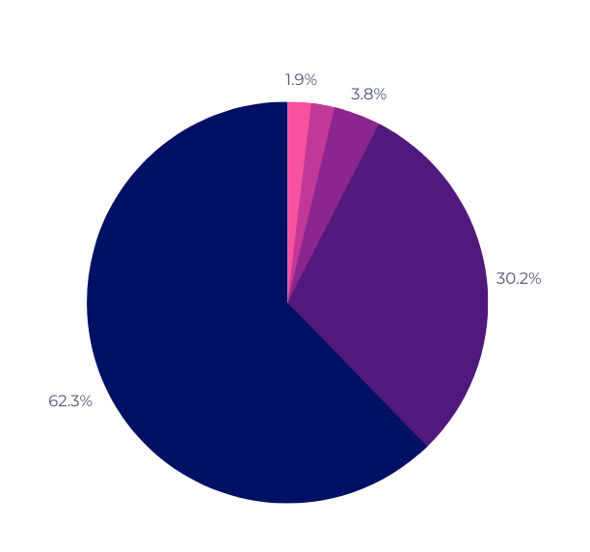
Survey statistics by students
In terms of satisfaction of the programme:
Are you satisfied with the EU4EU project?
Not at all
Not much
A little
Quite satisfied
Very satisfied

Slide 7
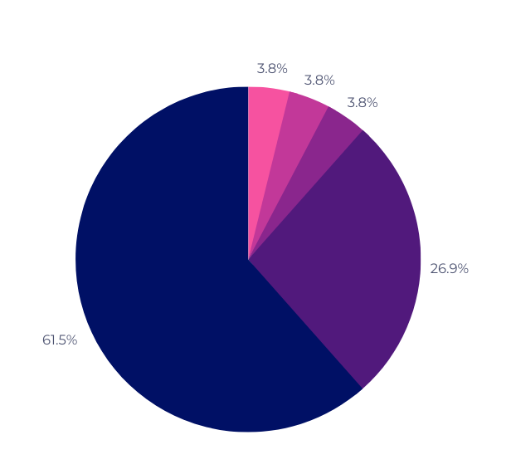
In terms of Support from the National Coordinator
Are you satisfied with the support from your national project coordinator?
Not at all
Not much
A little
Quite satisfied
Very satisfied

Slide 8
What is the
main difference between the
two projects?

Slide 9

Objectives achieved
High satisfaction with the programme by students who partecipated
High satisfaction with the support provided by the Italian National Consortium
Growth over the years in terms of numbers of completed applications

Slide 10
How were these results achieved?
Through Good Management Practices
Through Communication

Slide 11
Good Management Practices
Good Management practises used are:
Constant support for students at all stages of the Programme
Consistency of the procedures to be carried out in accordance with the Call for Application

Slide 12
Communication
How does the Italian Consortium use Internal Project Communication?
Through the speed of communication via email and telephone with students and all Universities in the consortium
Through clarity of information provided to students

Slide 13
Strenghts
Strong Knowledge of the Programme at national level, through a dissemination network between EuGen and Partner Universities
Efficient Programme Management of the National Consortium

Slide 14
What needs to be improved?
The shared communication strategy between EuGen and Partner Universities
Create greater involvement of all Consortium Partner Universities
Increase the number of scholarships to be awarded in order to meet the high student demand

Slide 15
How?
Requesting funds from the National Agency to cover more scholarship
Possibility of awarding EU4EU traineeships through funds available to Partner Universities

Slide 16
THANK YOU FOR YOUR
ATTENTION
Tonia URBANO - Project Officer
tonia.urbano@eu4eu.org
+39 3312063418
eu-gen.org
eu4eu.org

