Slide 2
European
Universities
for the
European
Union

Slide 3
WHAT?
EU4EU is the EuGen program co-financed with Erasmus+ funds that has created an international community of Universities, students and companies all over Europe to promote internships abroad.

Slide 4
Why?
To facilitate the transition between university education and access to employment, effectively promoting new job opportunities for graduates.
To help European companies to internationalise their team, grow and develop their business, explore EU funding opportunities, and accelerate the recruiting process.

Slide 5
HOW?
EuGen submits projects to the Erasmus National Agency to obtain the 7 year accreditation of the Consortium of Universities (KA131) and finance annual internships (KA130).
EuGen and the national co-ordinator manage the mobility project together, in harmony with the consortia in the other countries (the EU4EU European network).

Slide 6
HOW?
The national co-ordinator receives funding from the national Erasmus agency, publishes the call for applications and the results and pays the scholarships to students from all partner universities.
EU4EU network has been sharing and improving software, procedures, documentation, information material and helpdesk service for 8 years.

Slide 7
HOW?
Partner universities are called upon to promote the initiative to their students and to participate in the annual staff mobility.
They do not receive funding.

Slide 8
EU4EU NETWORK IN NUMBERS
62,000 students registered on the EU4EU portal
14,000 students completed registration
3,500 scholarships awarded
500 Host Organizations
46 Sending Universities

Slide 9
EU4EU NETWORK IN NUMBERS
8 years of activity
4 Sending Countries
1 Network annual meeting
90% Host Organizations “very satisfied” with the Program
92% Students very satisfied with their traineeship experience
96% Host Organizations very satisfied with the trainee

Slide 10
KEY PLAYERS
ITALY
2022
12 Universities
SPAIN
2022
14 Universities
PORTUGAL 2022
9 Universities

Slide 11
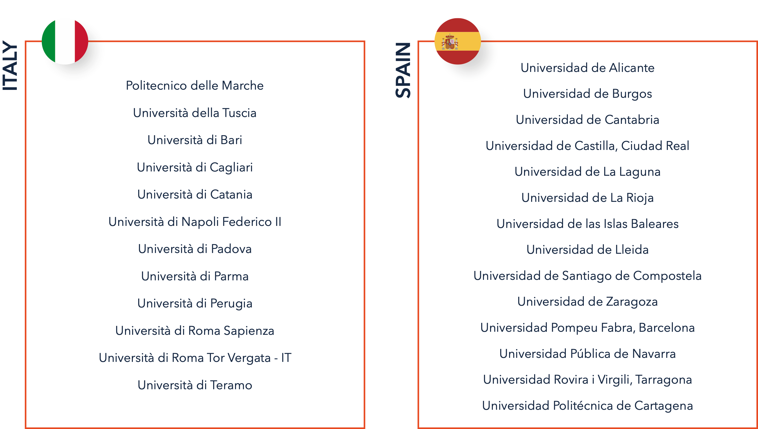
ERASMUS +
SCHOLARSHIPS

Slide 12
ERASMUS +
SCHOLARSHIPS

Slide 13
EU4EU SENDING HEI
9 PORTUGAL
11 FRANCE
12 ITALY
14 SPAIN

Slide 14
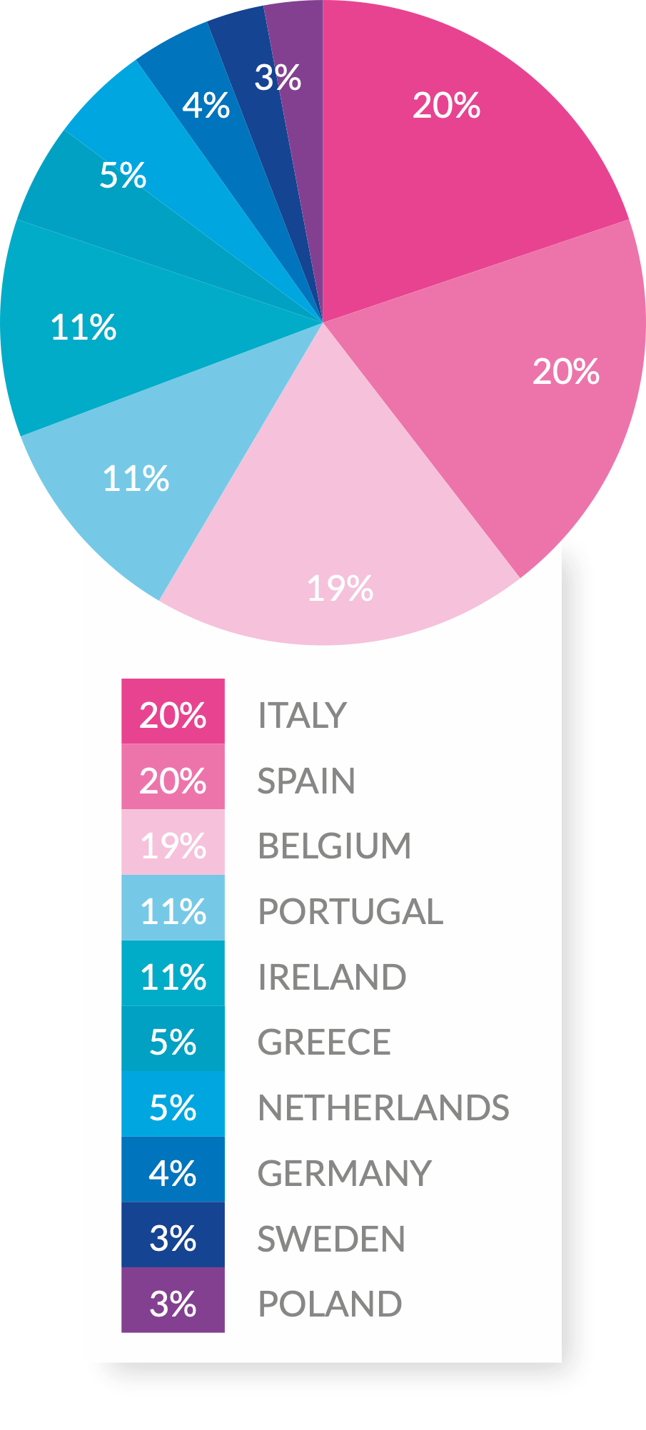
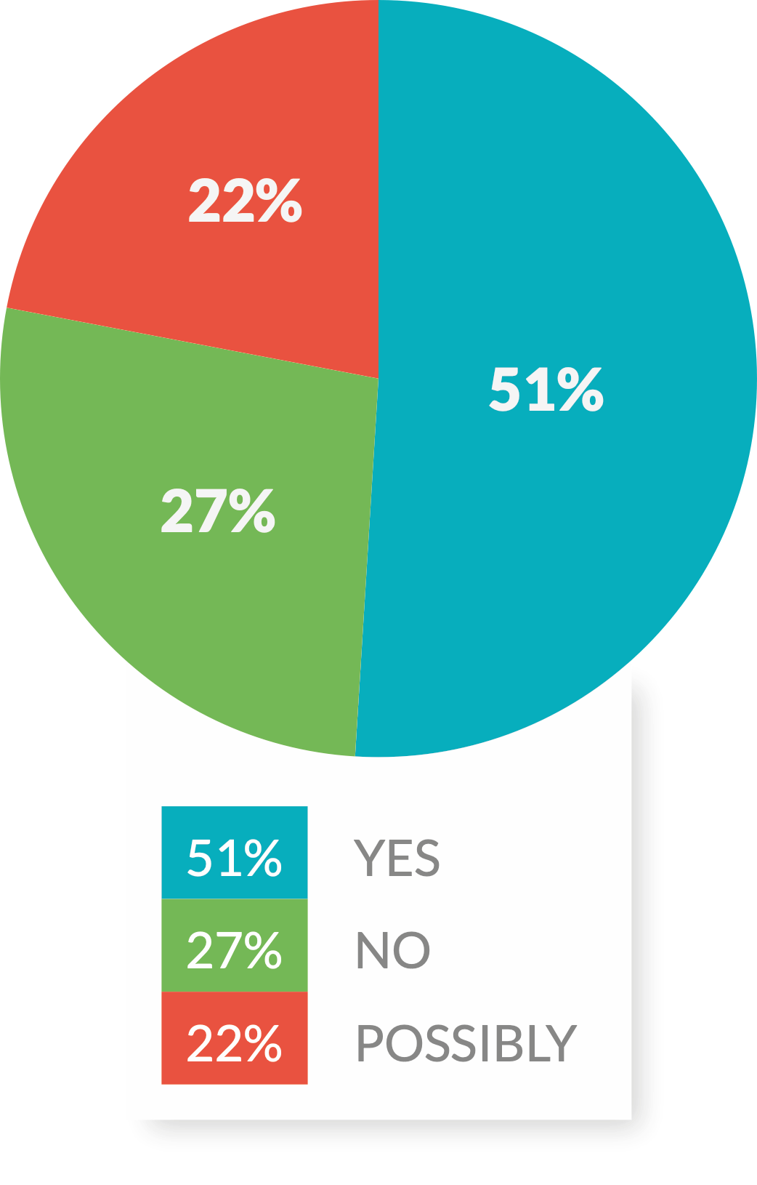
EU4EU HOST ORGANIZATIONS

Slide 15
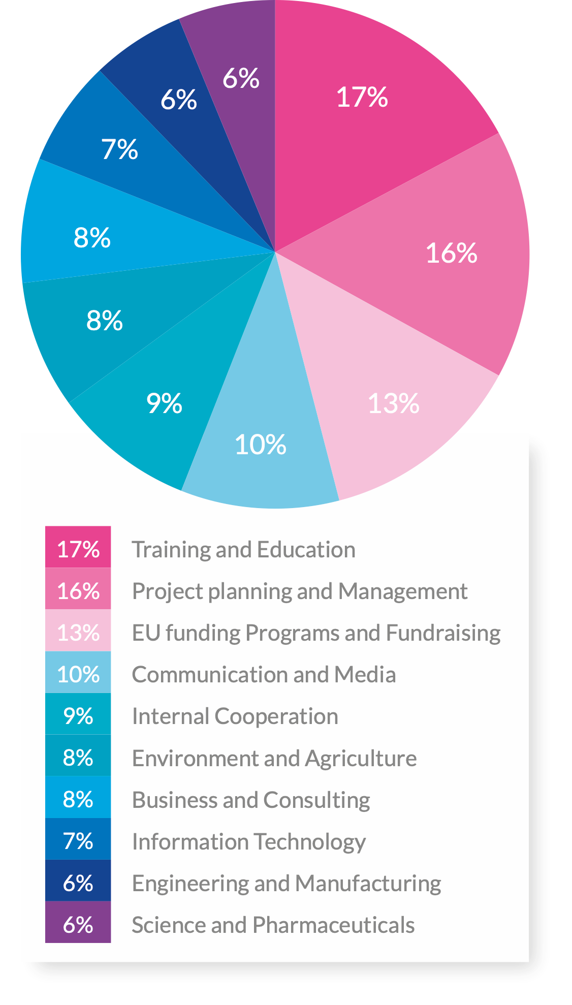
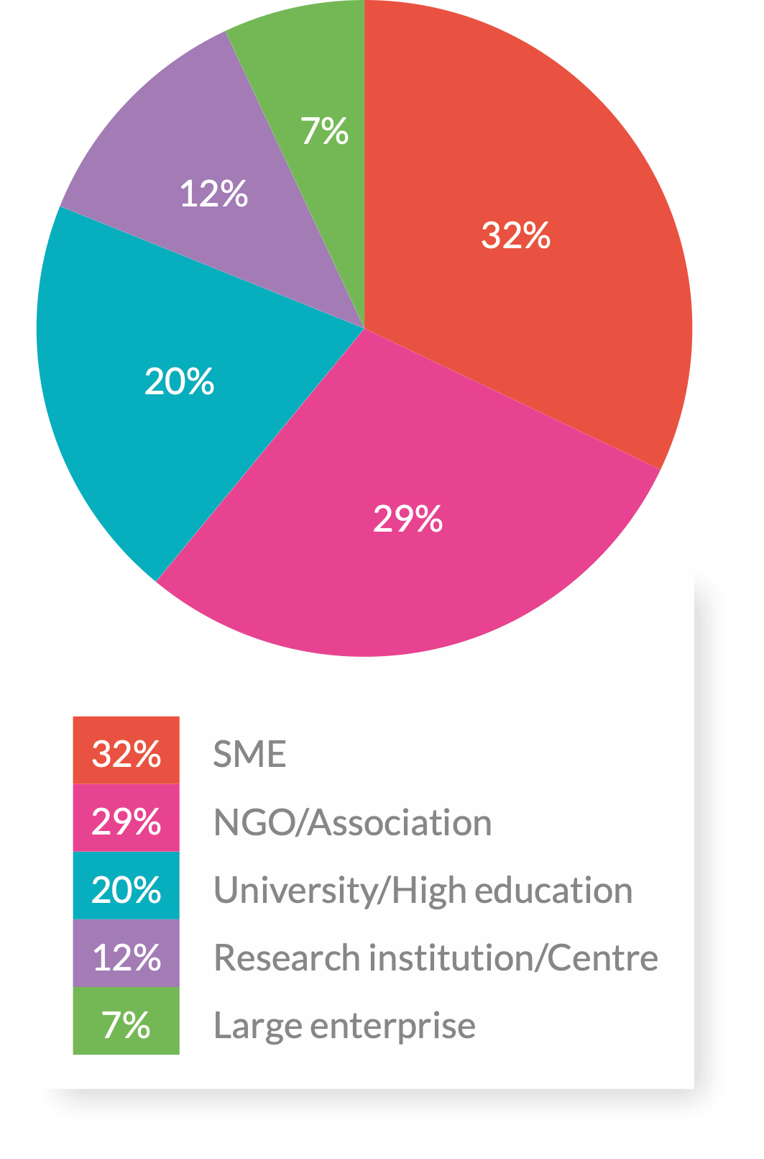
EU4EU HOST ORGANIZATIONS

Slide 16
SCHOLARSHIPS & MATCHINGS

Slide 17
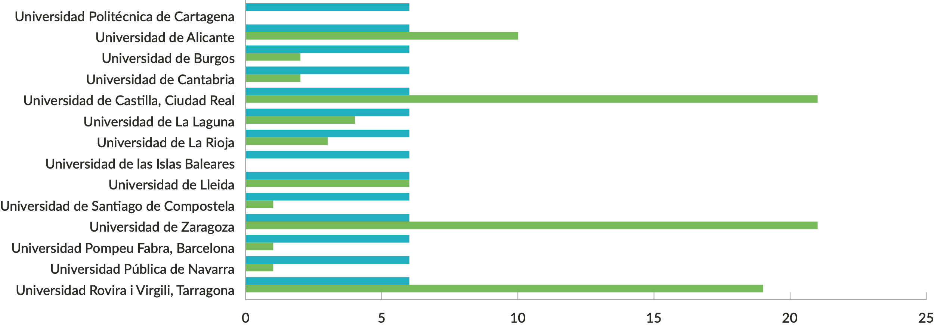
7 | 2
7 | 1
7 | 7
7 | 3
7
7
7 | 7
7
7 | 2
7 | 5
SCHOLARSHIPS & MATCHINGS
7 | 45
6
6 | 10
6 | 2
6 | 2
6 | 21
6 | 4
6 | 3
6
6 | 6
6 | 1
6 | 21
6 | 1
6 | 1
6 | 19

Slide 18
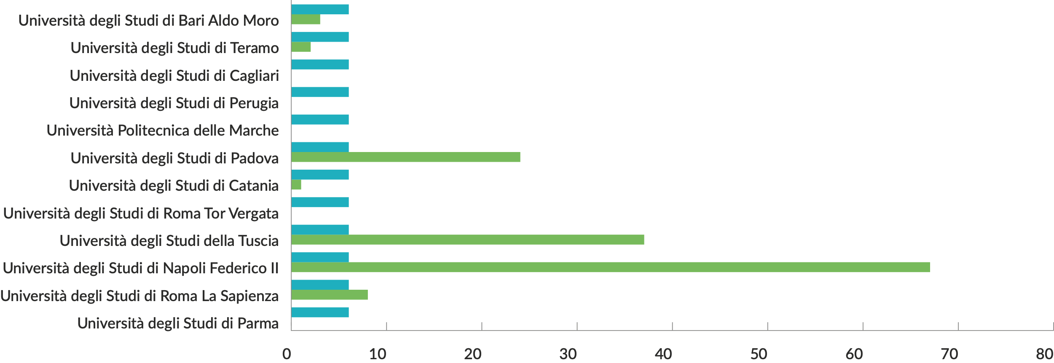
7
7 | 24
7
7
SCHOLARSHIPS & MATCHINGS
7 | 2
7 | 8
7 | 1
7
7
6 | 3
6 | 2
6
6
6
6 | 24
6 | 1
6
6 | 37
6 | 67
6
6 | 8

Slide 19
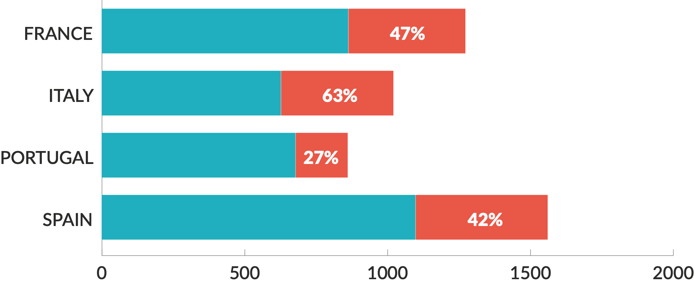
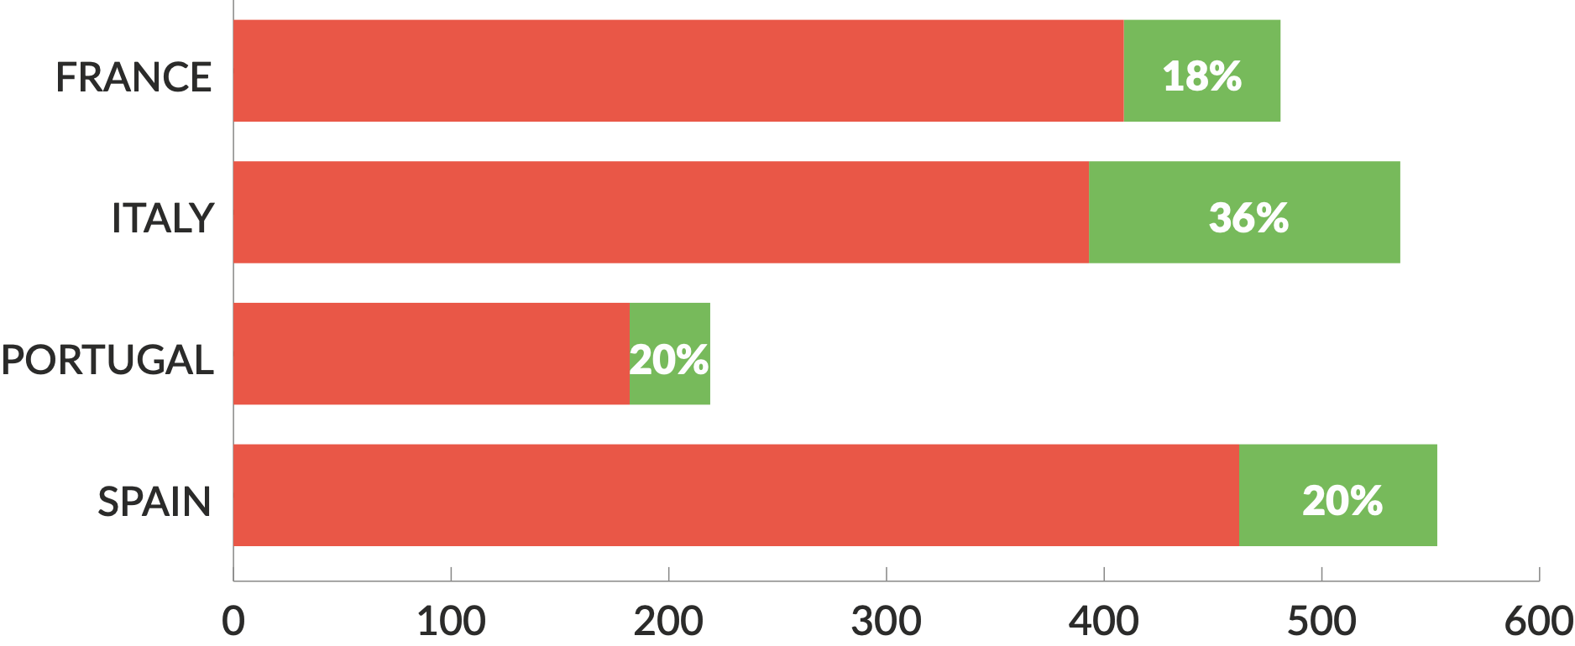
863
627
678
1098
409
393
182
462
SIGN UP
MATCHINGS
REGISTRATIONS
COMPLETED
409
393
182
462
72
143
37
91

Slide 20
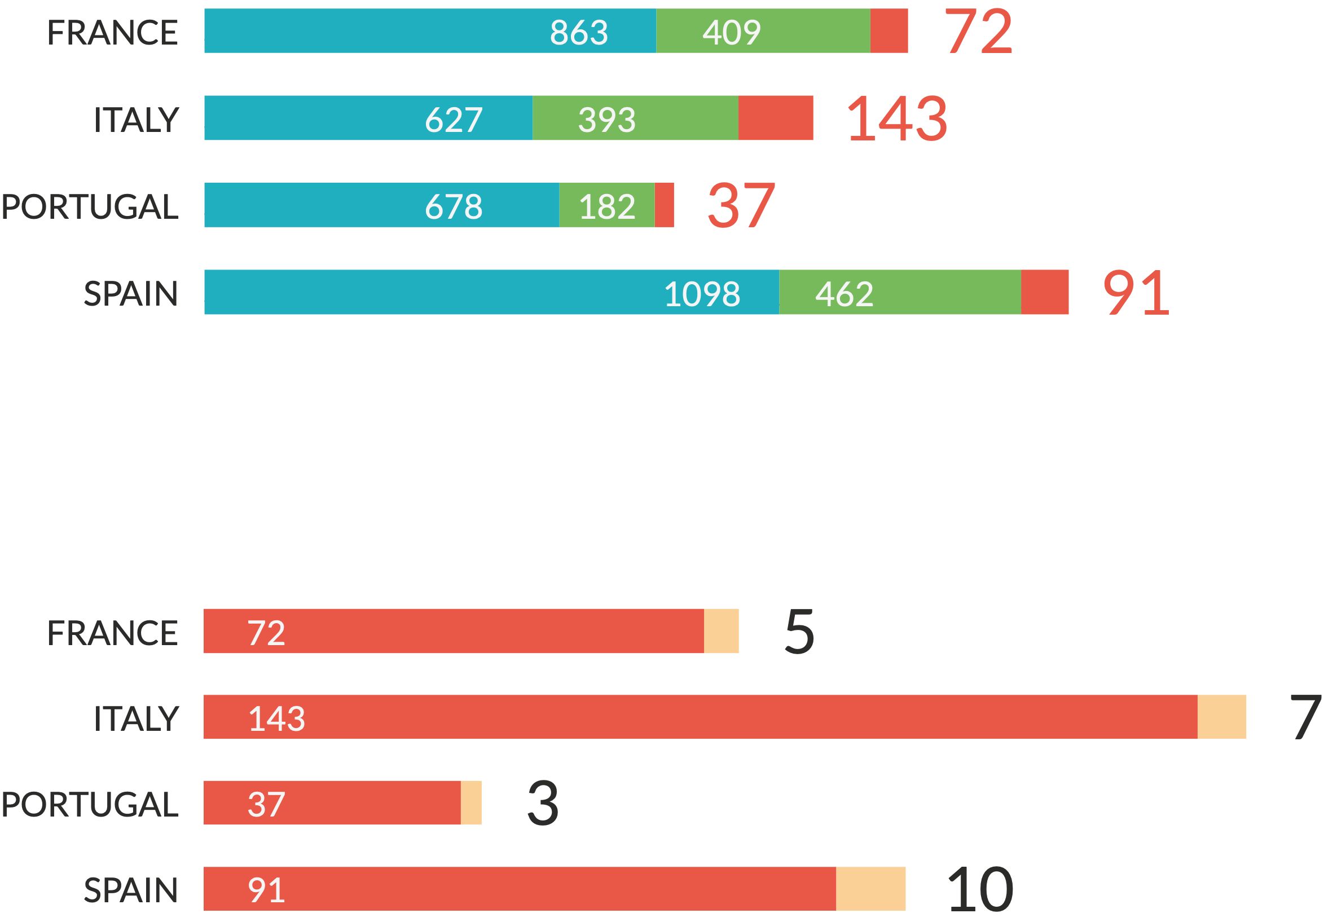
72
143
37
91
409
182
462
863
393
627
678
1098
SIGN UP
MATCHINGS
REGISTRATIONS
COMPLETED
5
7
10
3
72
143
37
91

Slide 21
EU4EU:
Listening for improvement
Francesca Zotta • 22/05/2023

Slide 22
TOPICS
ANALYSIS
Strengths
Weaknesses
Testimonials
SOLUTIONS
DB enhancement
Software improvement
Project policy improvement

Slide 23
EU4EU Features
Promotes international student mobility
Promotes the development of professional skills
Facilitates the matching of labour supply and demand
Provides financial support to students and companies

Slide 24
EU4EU
STRENGTHS
Added value for students:
Added value for Host Organizations:
Efficient Software
Wide Host Organizations Database
Clear rules
Good Communication
Efficient Helpdesk
Efficient Software
Wide Trainees Database
One Procedure
Clear rules
Reference Helpdesk

Slide 25
Students testimonials
Elèonore Henry • Université de Lille, France
INTERESTING DATABASE
“There are great offers to work in a lot of countries, it’s very easy to reach companies.”
Lucrezia Rivieccio • Università di Napoli, Italy
HELPDESK
“The experience proposed and the support offered by EU4EU team are excellent.”
Sofia Carvalho de Araujo Duarte Santos • University of Coimbra, Portugal
Mariana Duarte • University of Coimbra, Portugal
PROCEDURE
“Although there are a lot of steps in the application procedure I felt like they were well explained and clear.”
INTERESTING DATABASE
“I believe is a great project and it helped me a lot finding a very good internship. Without this platform, I don’t think I would be able to take any internship in any field and I’m very grateful for that.”

Slide 26
HOST ORGANIZATION testimonials
Nicola Nescatelli • Ecobubble, Italy
OVERALL
“Compared to other services, its added value is the wide range of students but with standardised, clear and orderly procedure and impeccable helpdesk service”
Kuttuvan Valappil, Sajna • Celignis Limited, Irland
SOFTWARE
“EUEU portal loads so fast and is very easy to use.”
Sebastian Schaffer • Institut fur den Donauraum und Mitteleuropa, Austria
Marina Aristodimou • Cross Culture International Foundation Cyprus - CCIF Cyprus, Cyprus
OVERALL
“It continues to provide us with possibilities to cooperate with trainees across borders and disciplines. The Portal keep improving, the new language search function is very much appreciated.”
OVERALL
“EU4EU offers an excellent internship program, highly effective which provides strong candidates choose from. Furthermore, a wide pool of items is built that could lead to future hiring opportunities.”

Slide 27
AREAS FOR
IMPROVEMENT
Broaden number and type of participants on the Host Organisation and student side
Accommodation
Improve communication between students and companies and support selection process
Scholarship amount

Slide 28
SOLUTION 1:
DB enhancement
Objective 1
Increase project participants in terms of Host Organisation and Students
Objective 2
To encourage the participation of Host Organisations and Students with specific thematic expertise

Slide 29
SOLUTION 2:
PORTAL IMPROVEMENT
Objective 1
Implementation of internal messaging system between Host Organisations and students
Objective 2
Automatic reminders to reduce the number of drop outs
Objective 3
Scheduling of interviews
Objective 4
Save searches and favourites

Slide 30
SOLUTION 3:
POLICY REFINEMENT
Objective 1
Request funding for more grants
Objective 2
Issue several calls during the year
Objective 3
Reducing the number of students cancelling after signing
Objective 4
Reducing the number of traineeship out of EU4EU

Slide 31
ACCOMODATION
A. Shared document addressed to DG EACEA
B. Favouring Hosts offering economic support
C. Student information support
D. Creation of EU4EU facebook group with former and new trainees
E. Site news
F. Involving Host Organisations and Universities in the home search for their trainees
G. Collaboration with ESN

Slide 32
THANK YOU
FOR YOUR
ATTENTION
Francesca Romana ZOTTA
EuGen President
francescazotta@eu-gen.org
@EU4EUnetwork
@eu4eunetwork
EU4EU - European Universities for the EU
eu4eu.org
info@eu4eu.org

Slide 33
And now… Debate time!
What ideas have you gained?
Do you have suggestions?
Do you want to address other critical issues?

