Slide 1
EU4EU STAFF MOBILITY IN CRACOW CAMPUS IBERUS (SPANISH COORDINATOR)
Marta De Miguel – Executive Director Carmen Ramón – Erasmus Technician
Andrés Martín – International Project Manager

Slide 3
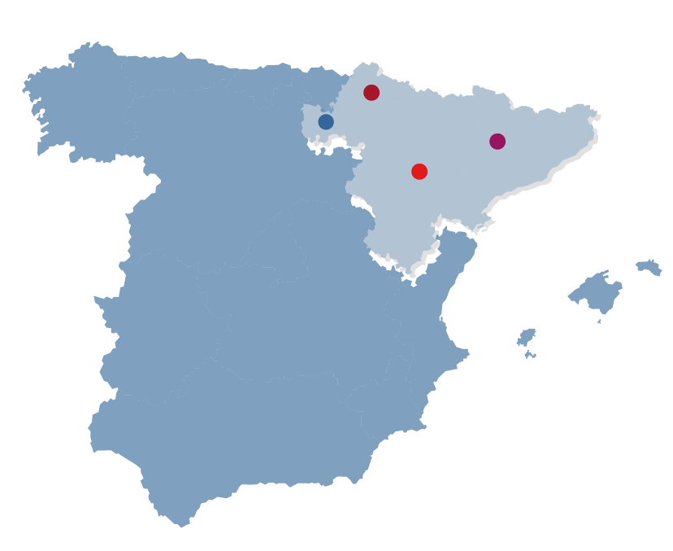
CAMPUS IBERUS DIMENSION
Strategic alliance of 4 Spanish Public Universities.
Aggregation of R&I resources of 4 Regions (Aragon, Navarre, Rioja, Lleida in Catalonia).
Students | 58.000
PhD students | 3.200
International PhDs | 316
Teaching & Research staff | 6.300
Technical & Admin staff | 3.000
Bachelor degrees | 150
Master degrees | 154
PhD degrees | 81
Research groups | 480

Slide 4
CAMPUS IBERUS PRINCIPLES
Aggregation
Education, R&I capacities
Research resources (infrastructure, clusters, staff)
Alliances with stakeholders (U-B cooperation)
Large mobility initiatives (students, R&T staff, talent attraction programmes PhDs, postdocs)
Specialisation
Internacionalisation
Agrofood & Nutrition
Energy & Environment
Health Technologies
Social & Territorial Development
Circular Economy & Bioeconomy
Europe
International: Latin-America (Colombia), Asia
Office in Bogotá

Slide 5
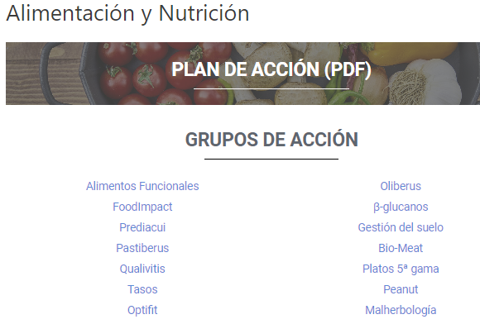
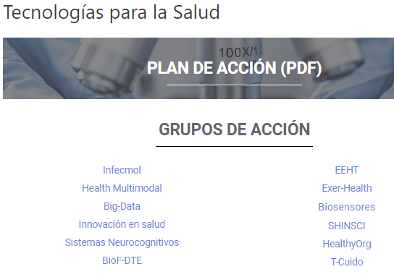
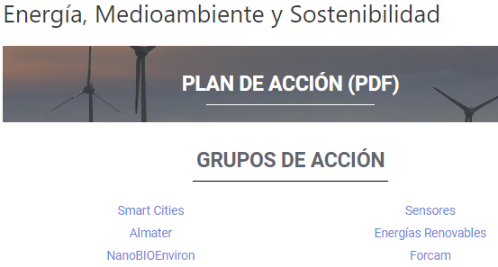
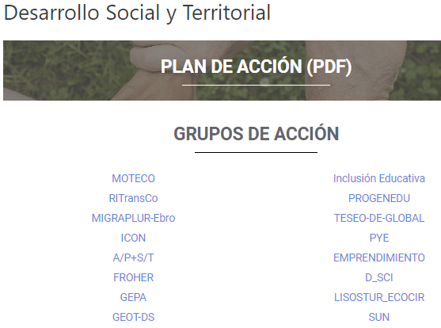
CAMPUS IBERUS RESEARCH CLUSTERS
5 Research Areas of strategic specialisation
49 Research Clusters
+750 researchers, +80 research organisations and economic stakeholders
AGRIFOOD - NUTRITION
HEALTH - TECHNOLOGY
ENERGY - SUSTAINABILITY
SOCIAL - TERRITORIAL DEV.
14 Clusters
12 Clusters
6 Clusters
16 Clusters
CIRCULAR BIOECONOMY
At least two Campus Iberus universities
Including economic stakeholders
International organisations
R&I funds and talented researchers
2 Clusters

Slide 6
SPANISH UNIVERSITIES FOR EU PROJECTS

Slide 7
SPANISH UNIVERSITIES FOR EU PROJECTS
We started our project in 2017 with 13 universities
6 years of projects and one more in the process of evaluation
New University in 2022 – Politécnica de Cartagena
The first challenges:
Define common standards in the call
Students platform
Dissemination

Slide 8
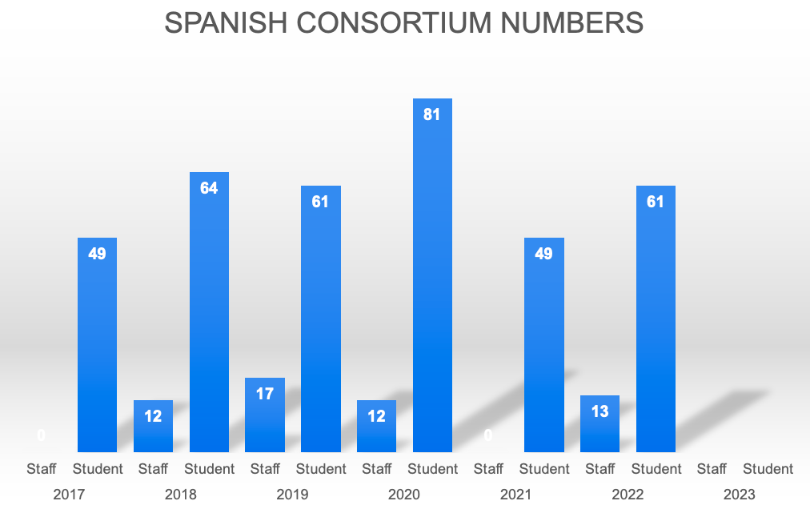
SPANISH UNIVERSITIES FOR EU PROJECTS

Slide 9
NEW CHALLEGES FOR EU 4 EU
Quality and improve employment rates
Cost of living in big cities
Encourage collaboration within the network
Dissemination among students

Slide 10
GRACIAS

Slide 11
WORKSHOP 2
BLENDED INTENSIVE PROGRAMME
(BIP COURSES)

Slide 12
BLENDED INTENSIVE PROGRAMME
For bachelor's and master's degree students
For staff
For PhD students
1
3
5
BIP
BIP
BIP
BIP
BIP
2
BIP
BIP
4
BIP
BIP
6
BIP
BIP
BIP
BIP
BIP
BIP

Slide 13
BLENDED COURSE STRUCTURE
SEND (COUNTRY 2)
SEND (COUNTRY 4)
SEND (COUNTRY 3)
HOST (COUNTRY 1)

Slide 14
BLENDED INTENSIVE PROGRAMME
For bachelor's and master's degree students
How we ensure recognition of 3 ECTS credits?
How do we allow host country students from different cities to participate?
1
BIP
What kind of training courses would be relevant in this type of format?
BIP
BIP
2
One course per year or one course per country per year?
BIP
BIP

Slide 15
BLENDED INTENSIVE PROGRAMME
For staff
How do we allow host country staff from different cities to participate?
What kind of training courses would be relevant in this type of format?
1
BIP
Who can provide and prepare such training
BIP
BIP
2
One course per year or one course per country per year?
BIP
BIP

Slide 16
BLENDED INTENSIVE PROGRAMME
For PhD
How do we allow host country PhD from different cities to participate?
1
What kind of training courses would be relevant in this type of format?
BIP
BIP
BIP
2
One course per year or one course per country per year?
BIP
BIP

Slide 17
WORKSHOP 3
PARTNERSHIPS FOR COOPERATION (ERASMUS KA2)

Slide 18
KA2 WORKSHOP AGENDA
Introduction (15-20 minutes)
Identification of common needs and potential outcomes and activities (20 minutes) – Brainstorming
Generation of project ideas (30 minutes) - Project Template
Presentation of results by groups (25 minutes)
Conclusions and closing (5 minutes)

Slide 19
KA2 PROJECTS

Slide 20
PRIORITIES APPLYING TO ALL ERASMUS+ SECTORS
Inclusion and diversity in all fields of education, training, youth and sport
Environment and fight against climate change:
Addressing digital transformation through development of digital readiness, resilience and capacity:
Common values, civic engagement and participation

Slide 21
HIGHER EDUCATION PRIORITIES
Promoting inter-connected higher education systems
Stimulating innovative learning and teaching practices
Developing STEM/STEAM in higher education, in particular women participation in STEM
Rewarding excellence in learning, teaching and skills development,
Supporting digital and green capabilities of the higher education sector
Building inclusive higher education systems
Supporting innovation and entrepreneurial skills of students
Supporting Higher Education institutions in their cooperation with Ukrainian counterparts to respond to thewar in Ukraine

Slide 22
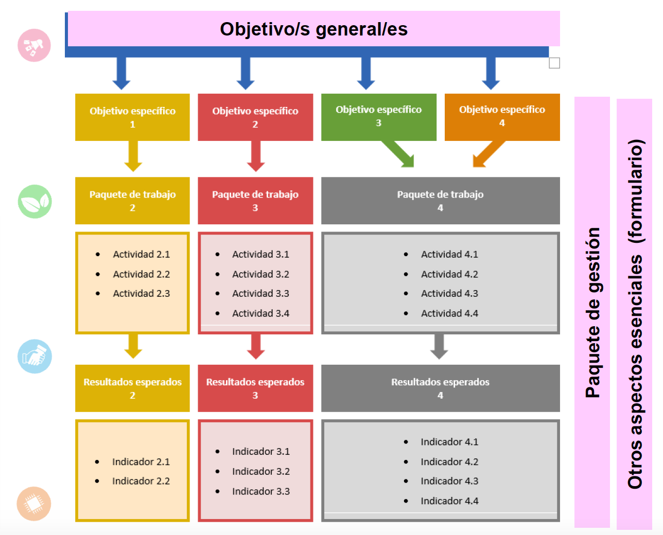
PROJECT STRUCTURE

Slide 23
WORKPACKAGE
“A set of activities that contribute to the achievement of common objectives and one or more results.”
Maximum 4 work packages

Slide 24
TEAM WORK
Identification of common needs and potential outcomes and activities (20 minutes)
Brainstorming

Slide 25
TEAM WORK
Generation of project ideas (30 minutes)
Project Template

Slide 26
TEAM WORK
Presentation of results by groups (25 minutes)

